Slide 1
Outline of Workshop
First thing: How to use Jupyter Notebooks Morning (pre-break):
Stuff
Morning (post-break):
Stuff
Afternoon:
Stuff
Statistical prerequisites: assuming

Slide 2
Introduction to Jupyter
“Interacting Computing Environment” allowing code, plots, texts, equations, etc. to be created and shared
Requirements:
Python 2.7 or ≥3.3 (even if working in R)
Web application (Jupyter Notebook app in browser)
Language-specific Kernel (R or Python)

Slide 3
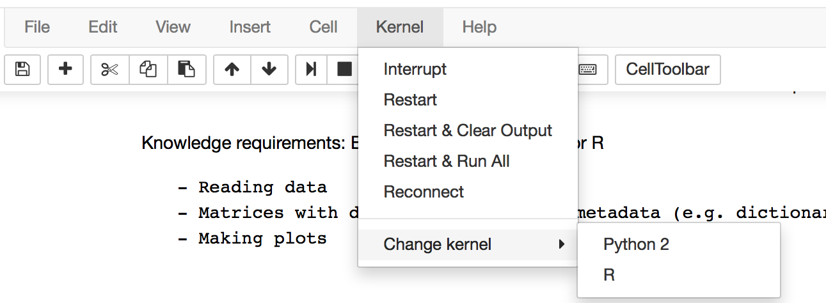
Installing Jupyter Notebooks
Download python2.7 Anaconda distribution from https://www.continuum.io/downloads and follow the on-screen instructions to install Python.
Jupyter is included with the Anaconda python installation! If working in R, you also need to install the R kernel with the following command:
conda install -c r r-essentials
Now you go to the folder containing your Jupyter notebook files in command line and launch Jupyter Notebooks:
jupyter notebook *If in Windows, use the Anaconda prompt, instead of cmd
If you want to back and forth between Kernels, You can change the kernel between Python and R under the Kernels tab:

Slide 4
Other Requirements
Python
The main packages used in the workshop (e.g. Numpy, Scipy, Matplotlib, Pandas) come pre-installed with your Conda installation. However, you also need to install statsmodels and rpy2 by using the conda install command in terminal:
conda install statsmodels
conda install rpy2
R
At R command prompt, type: install.packages(c(‘nlme’, ‘fields’, ‘geoR’))

Slide 5
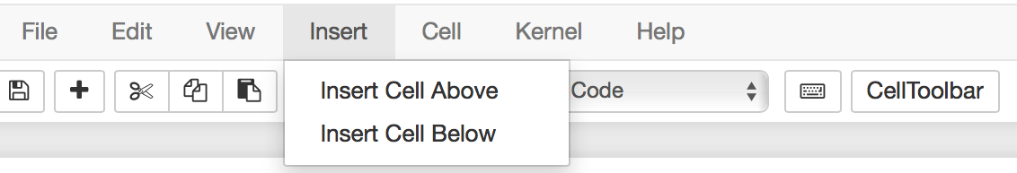
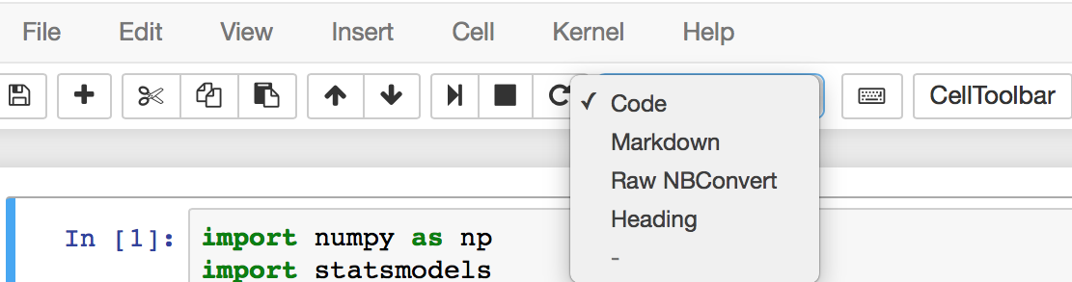
How to use Jupyter Notebooks
Everything goes inside ‘cells’. Create a cell:
Determine cell type:
Markdown for text, headers, equations;
Code for Python or R code that needs to be run (i.e. produces output).

Slide 6
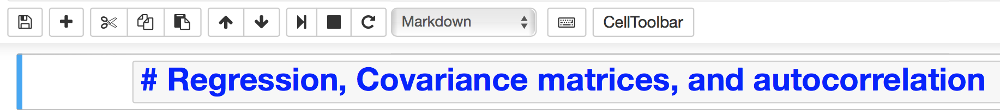
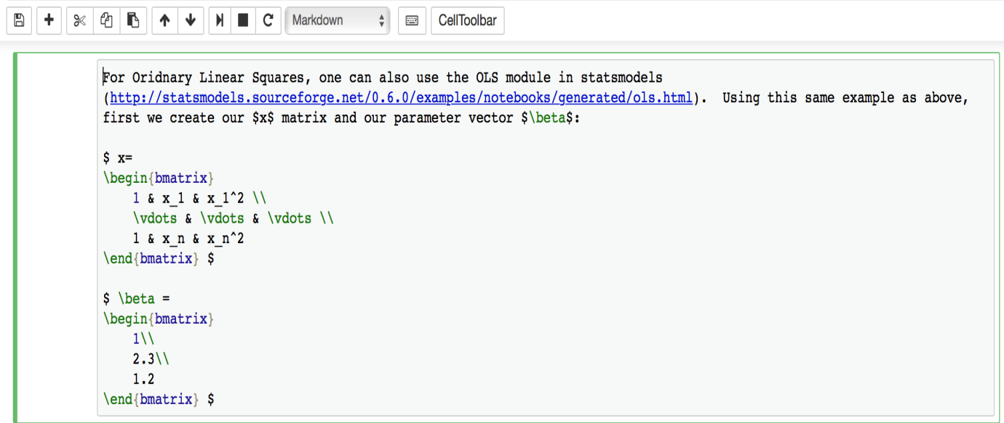
How to use Jupyter Notebooks (cont’d)
Convert Markdown to Header by simply using a # before the text and then run the cell:
Can also use Latex in Markdown:

Slide 7
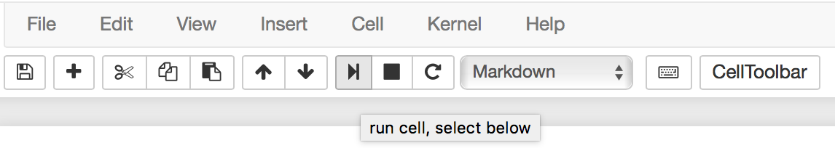
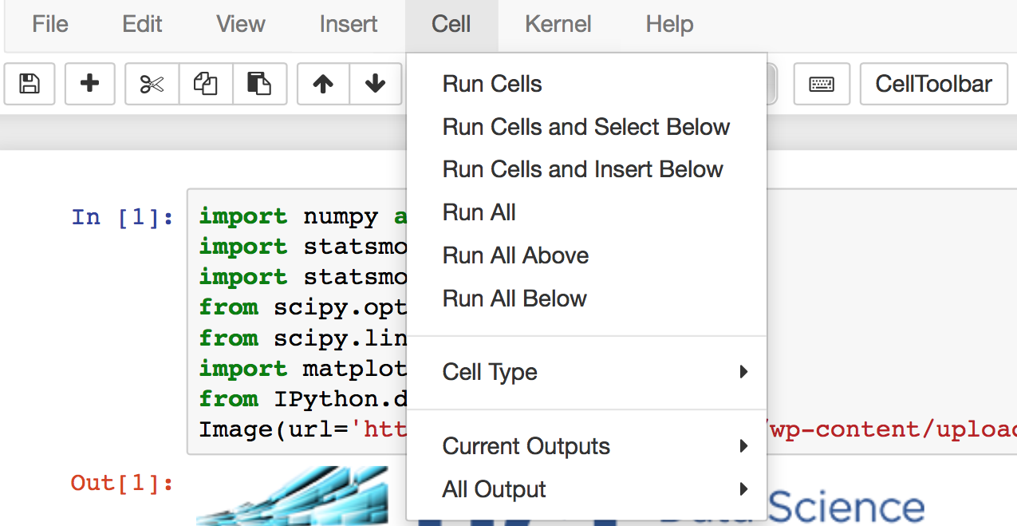
How to use Jupyter Notebooks (cont’d)
You can run each block of Mardown or code and get an output box:
Or run them all together:

Slide 8
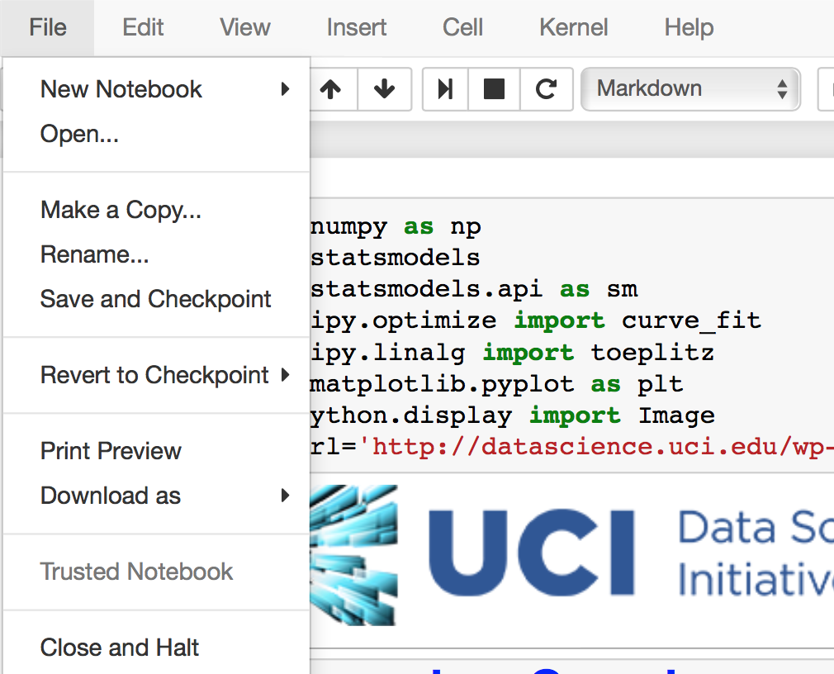
How to use Jupyter Notebooks (cont’d)
Finally, you can save a notebook when you’re done editing:
And close the kernel:

Slide 9
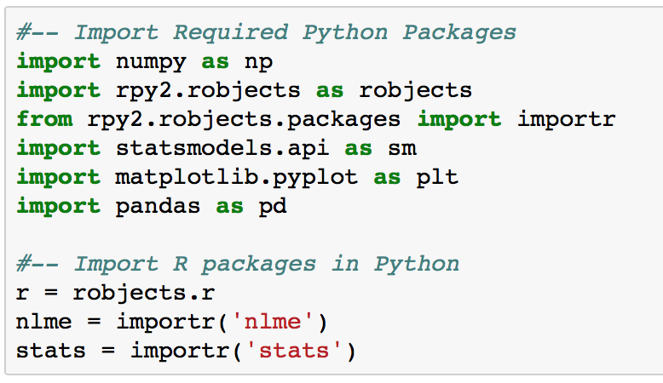
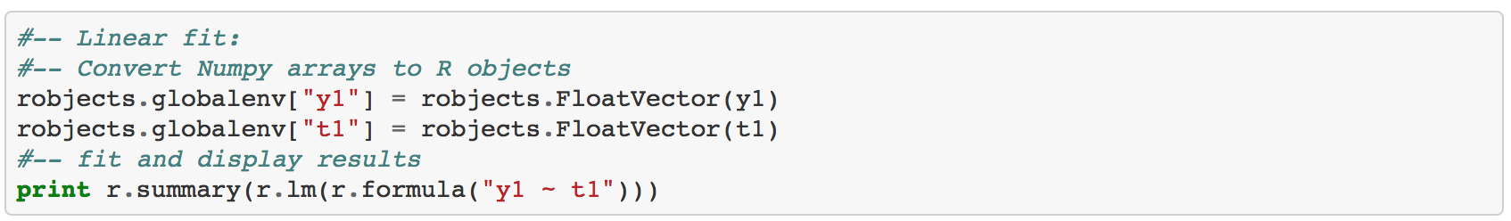
Implementing R in Python
Use rpy2 package and import required R packages:
Python objects have to be converted to R objects and sent to the R environment. Example: numpy array to R FloatVector:

Slide 10
Implementing R in Python (cont’d)
R functions are called with robjects.r.function()
Function names are the same, except ‘.’ changed to ‘_’. (e.g. arima.sim → stats.arima_sim)
Model formulas passed on with ‘r.formula(“formula”)’.
Examples:

Slide 11
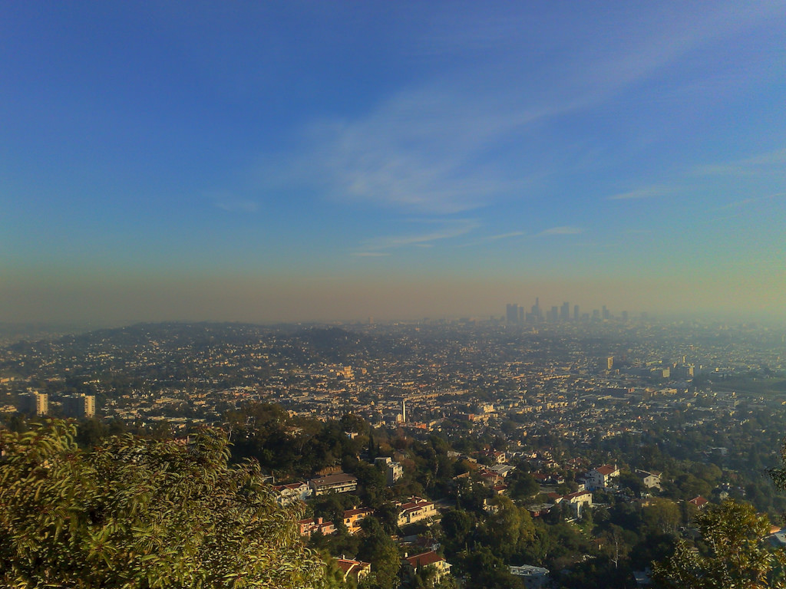







An Introduction to Environmental Statistics
UCI Data Science Initiative Short Course Gregory Britten (gbritten@uci.edu), Yara Mohajerani (ymohajer@uci.edu)
Notes:
Workshop has been in the making for a while
Part of larger workshop effort in environmental statistics
Personal research in oceanography, Yara in glaciology, but interested in applied statistics and data science generally applied to environmental science
Not Bayesian at all
Common goals include analysis of trends, dynamics, statistical significance

Slide 12
Is there a statistical trend in observed air quality? Are times of the year systematically worse? What environmental factors contribute to the trend?
Notes:
Air quality of primary concern in Southern California
May want to ask these questions of data and determine the statistical strength of the evidence
Measure this field for concentrations which will exhibit particular statistical properties, regional trends, ‘clumpiness’, statistical relation to other variables.
Aligned with goals of applied statistics
We’ll talk about the statistical processes that generates

Slide 13
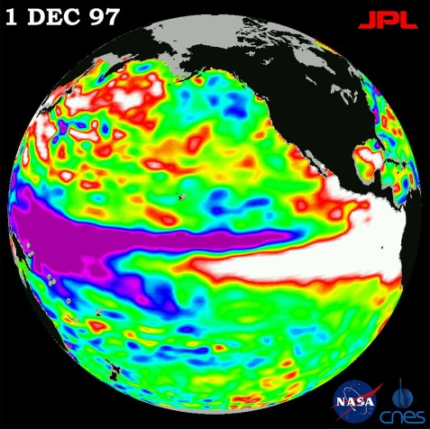
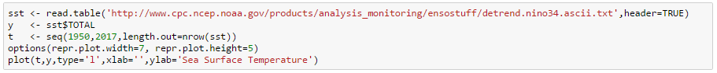
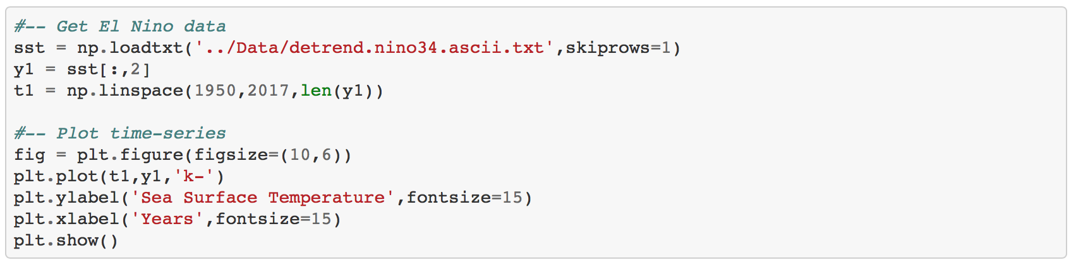
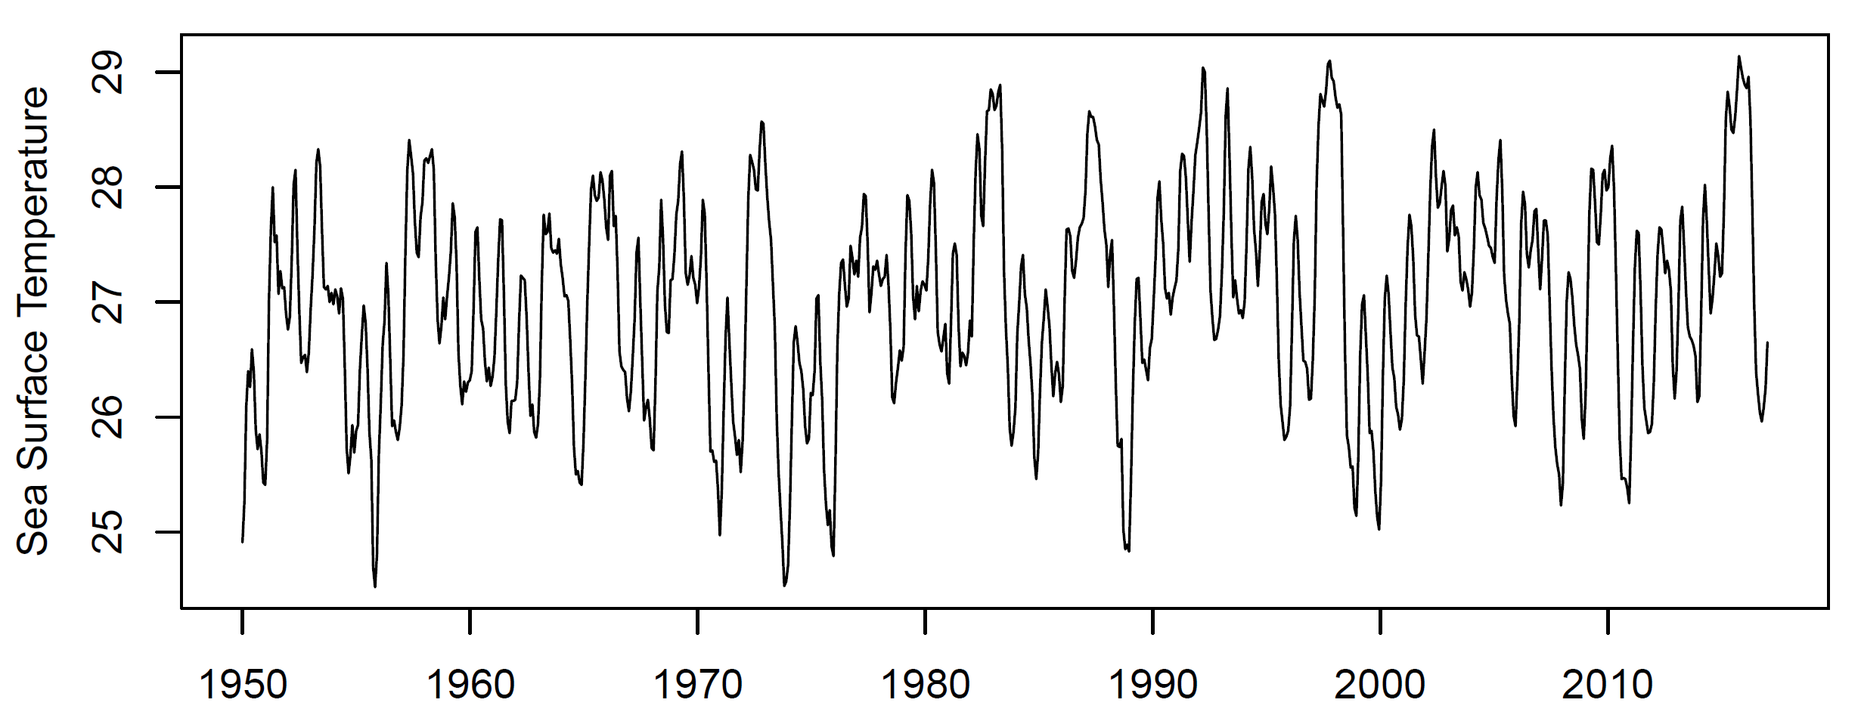
El Nino index: SST off the coast of Central America
Autocorrelation: ‘correlation with self’; measurements closer in time are more correlated (similar in value)
Periodicity: The earth spins and orbits the sun! Seasonal, daily, and other climate cycles are fundamental and seen in many datasets
R
Python
Sea Surface Temperature
Notes:
Take a look at a representative environmental time series
Clumpiness in time,
Downloaded from NOAA dataset
Much like the ozone case, we might be interested characterizing the regional variability, the clumpiness, the trend, etc.

Slide 14
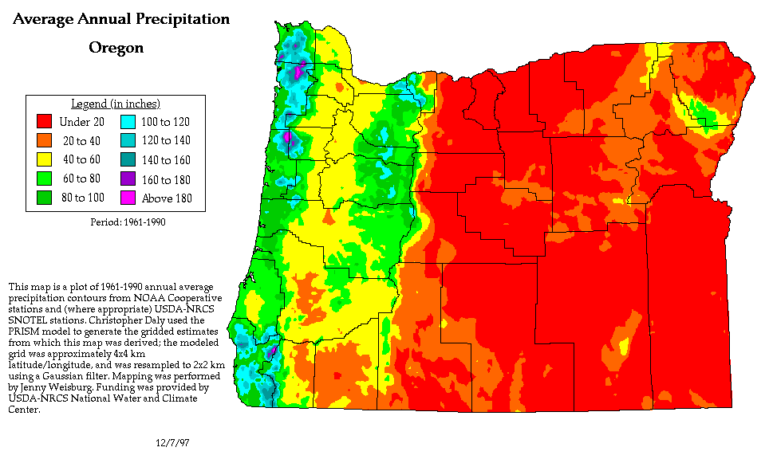
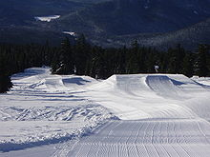
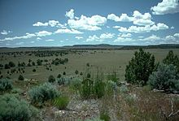

Slide 15
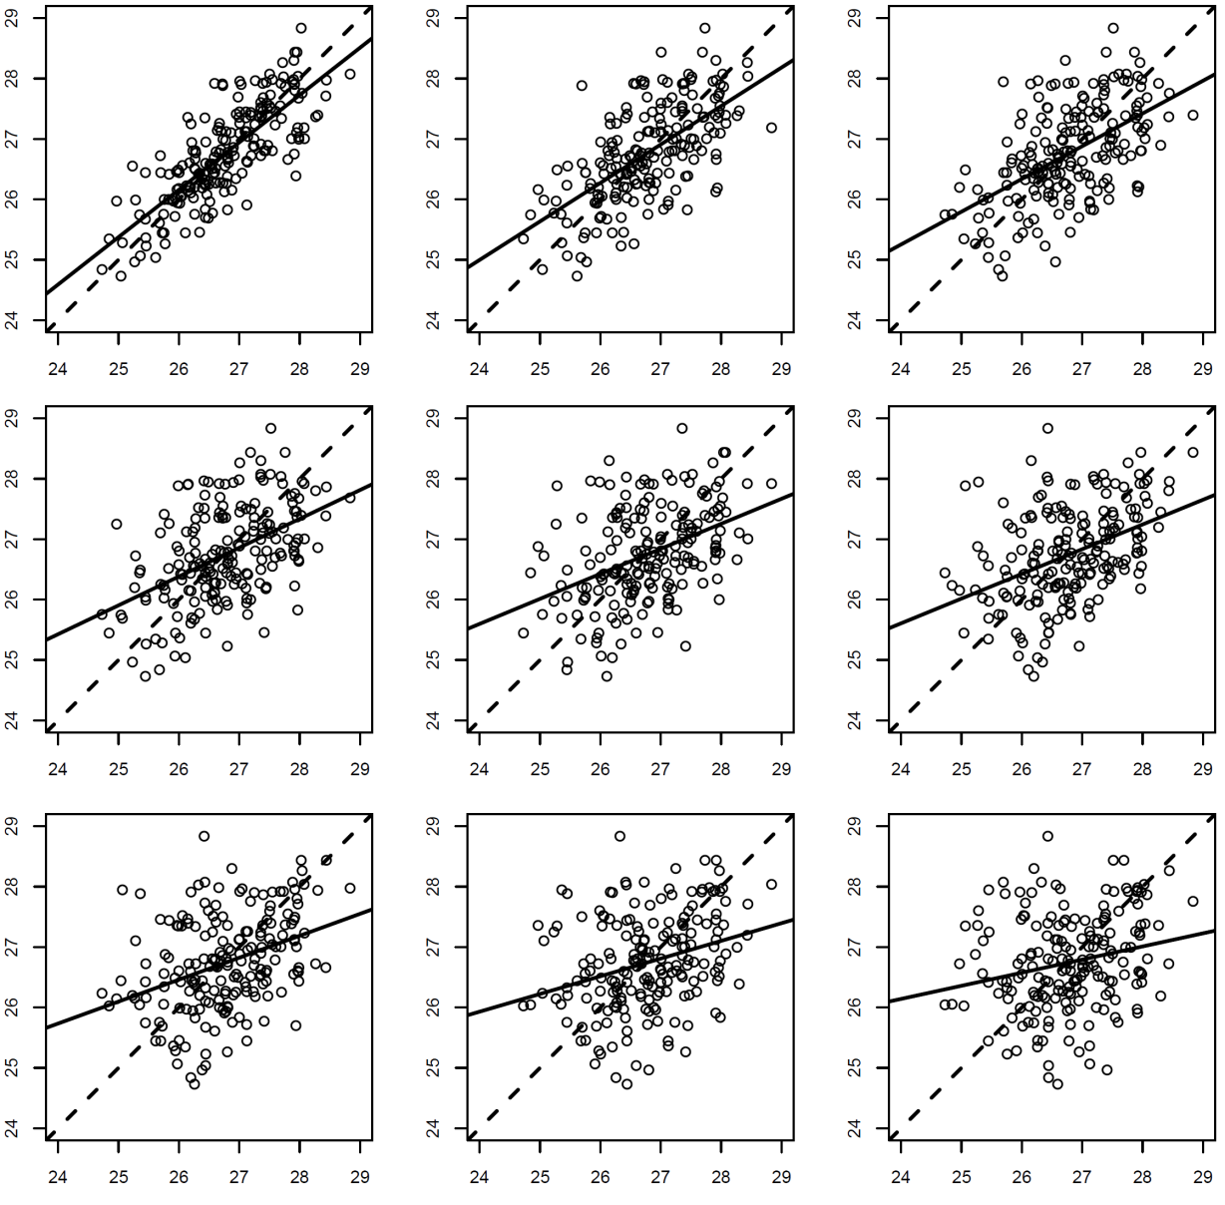
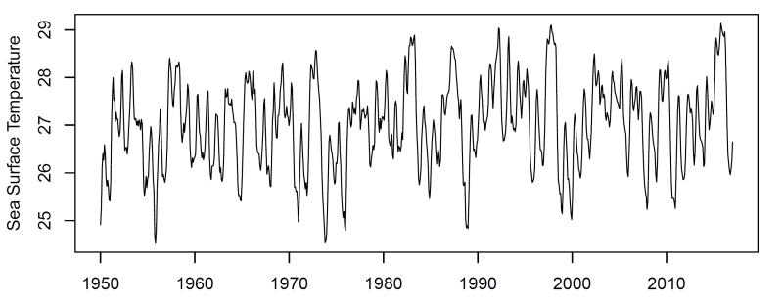
What Generates the Pattern? Key concept: autocorrelation as a function of lag
Places closer to one another are more similar => autocorrelated
Correlation falls away as a function of temporal distance, or lag
‘Autoregressive’ pattern

Slide 16
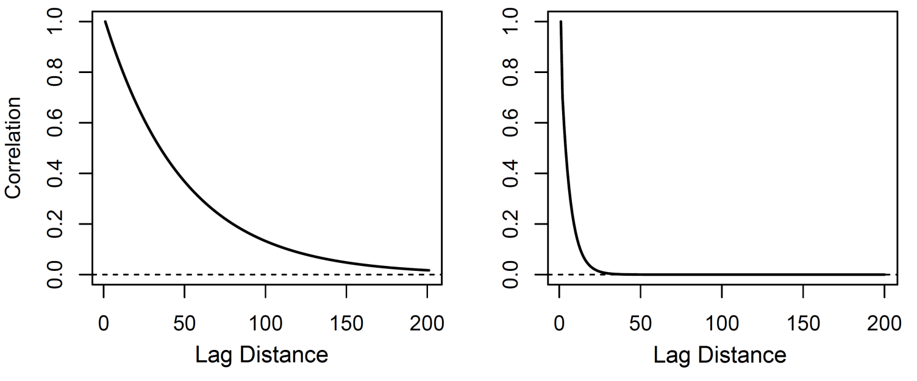
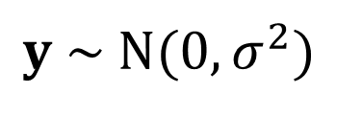
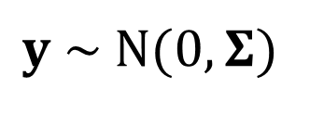
Autocorrelation functions
The autocorrelation function is a curve that provides a value for the expected correlation as a function of lag, which can be in time or space
We’d like to account for spatial correlation when statistically analyzing data because it affects confidence intervals, p.values, posterior probabilities..
We’ll focus on using Gaussian distributions with formatted covariance matrices
$$y \sim N(0,σ^{2})$$
$$y \sim N(0,Σ)$$
single variance parameter
covariance matrix

Slide 17

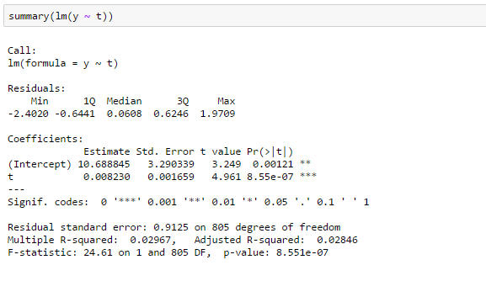
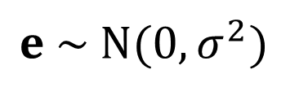
Is there a trend? ..a first attempt
R
Python
This is a straight line time series regression model assuming data are generated from independent (non-autocorrelated) process
$$e \sim N(0,σ^{2})$$
Indicates strong evidence Alert the press, the ocean is warming!

Slide 18
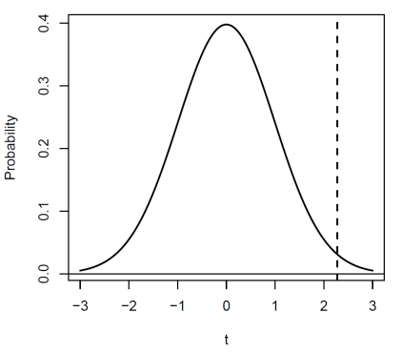
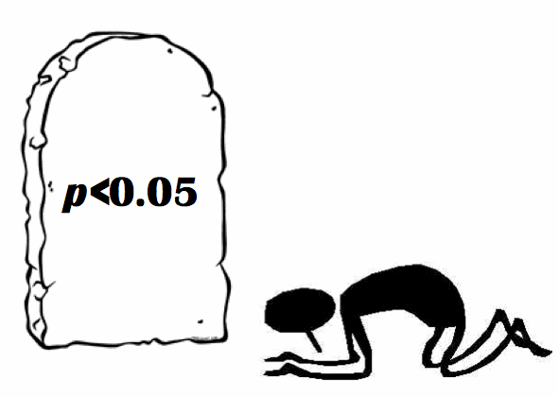
The logic of classical hypothesis testing
A p.value postulates an ensemble of sample realizations under a hypothetical null model
Suppose the true trend in a system is zero (our null model) Under repeated random time series sampling from this null model, what is the probability of calculating a trend of equal or greater magnitude than the I found in my dataset? -> If the probability is sufficiently low, one rejects the null model
We’ll need very different null models when data are autocorrelated

Slide 19
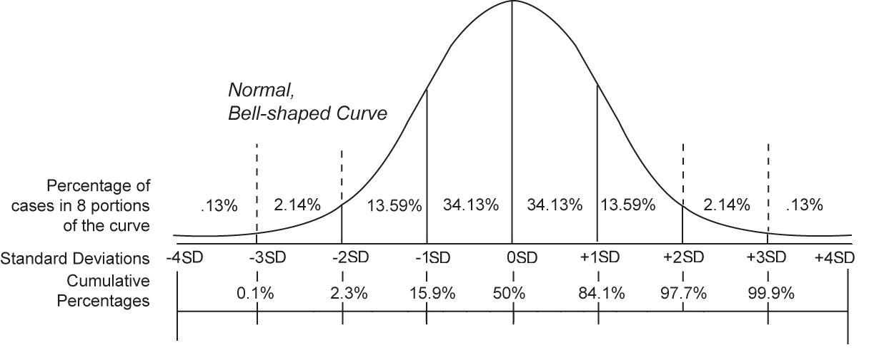
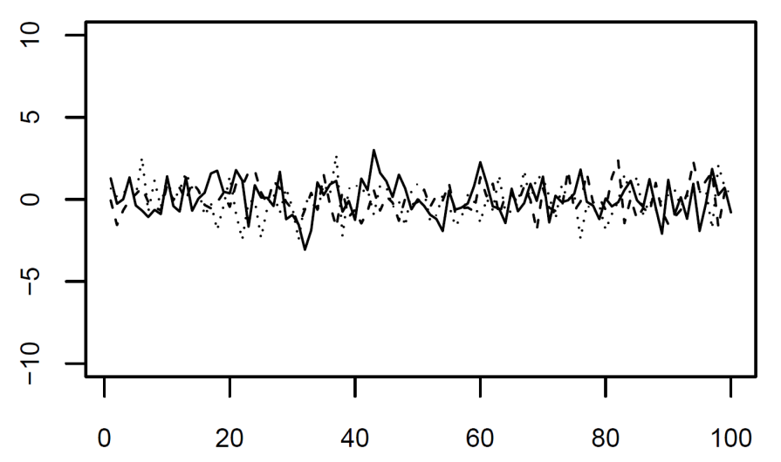
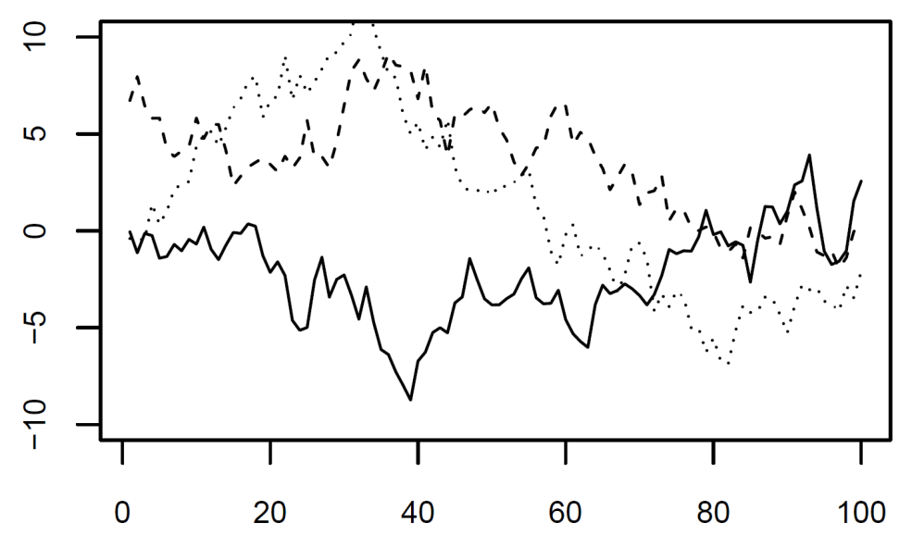
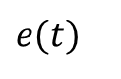
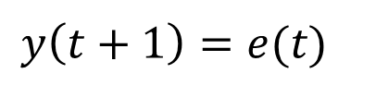
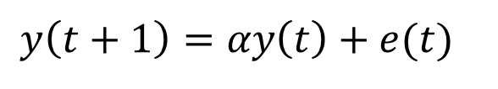
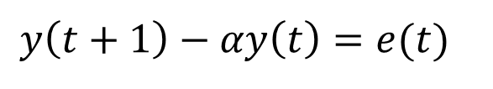
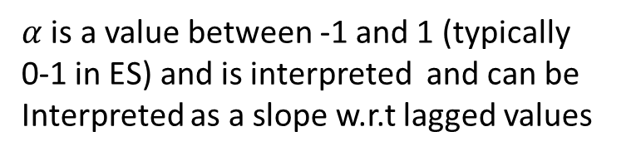
The concept of stochastic realization
$$y\left(t+1\right)=e(t)$$
$$y\left(t+1\right)=αy\left(t\right)+e(t)$$
$$y\left(t+1\right)−αy\left(t\right)=e(t)$$
*autoregressive model
$α$ is a value between -1 and 1 (typically
0-1 in ES) and is interpreted and can be
Interpreted as a slope w.r.t lagged values
$$e(t)$$

Slide 20
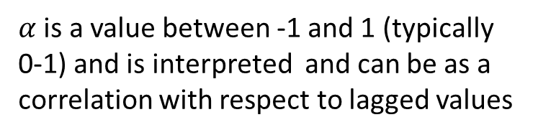
The concept of stochastic realization
$$y\left(t+1\right)=e(t)$$
$$y\left(t+1\right)=αy\left(t\right)+e(t)$$
$$y\left(t+1\right)−αy\left(t\right)=e(t)$$
*autoregressive model
$α$ is a value between -1 and 1 (typically
0-1) and is interpreted and can be as a
correlation with respect to lagged values
$$e(t)$$

Slide 21
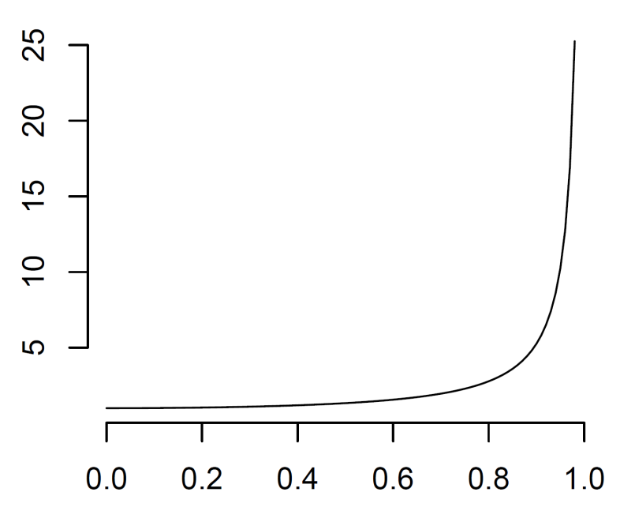
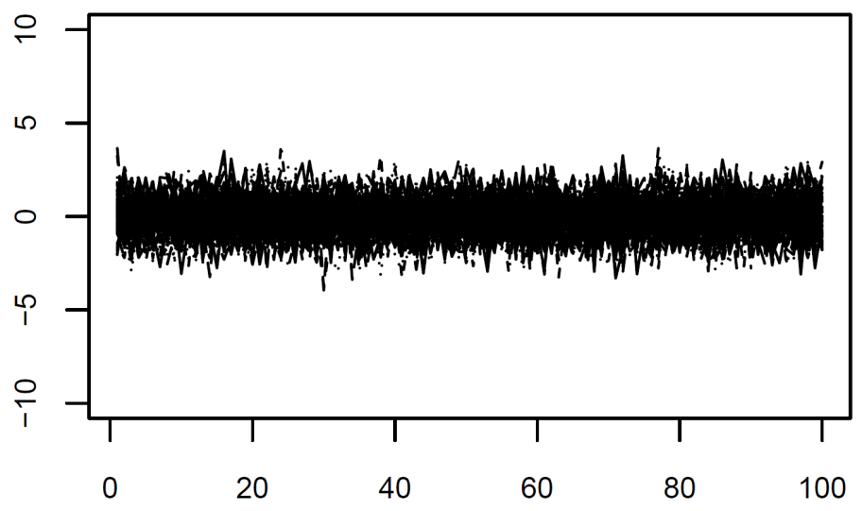
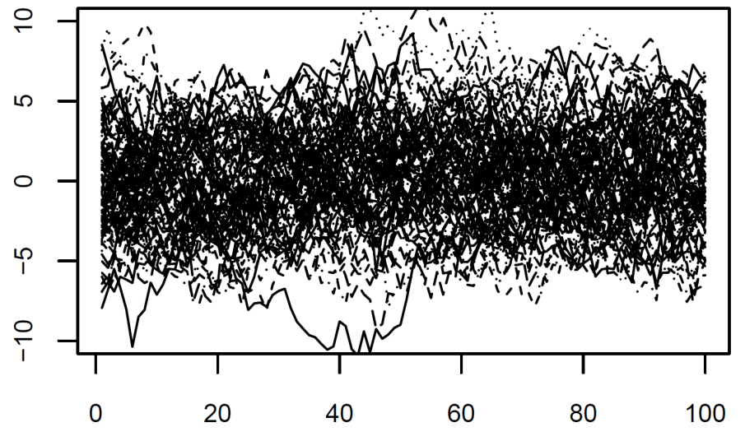
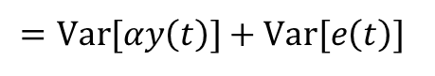
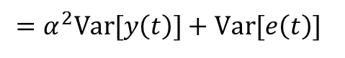
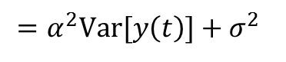
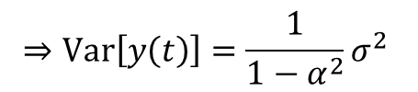
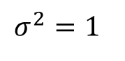
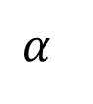
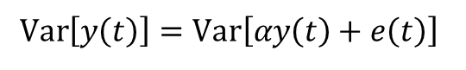
Theory: the expected variance of a temporal process increases with autocorrelation
$$Var\left[y\left(t\right)\right]=Var\left[αy\left(t\right)+e\left(t\right)\right]$$
$$σ^{2}=1$$
$$=Var[αy\left(t\right)]+Var[e\left(t\right)]$$
$$=α^{2}Var[y\left(t\right)]+Var[e\left(t\right)]$$
$$=α^{2}Var[y\left(t\right)]+σ^{2}$$
$$⇒Var\left[y\left(t\right)\right]=\frac{1}{1−α^{2}}σ^{2}$$
$$α$$

Slide 22
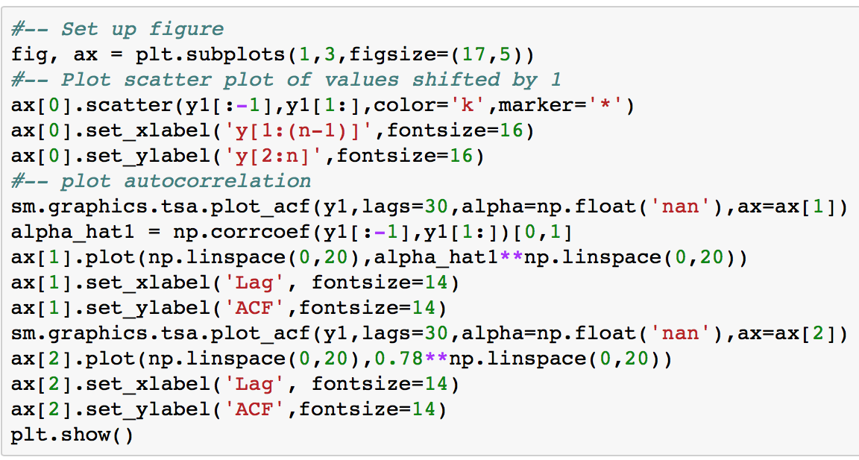
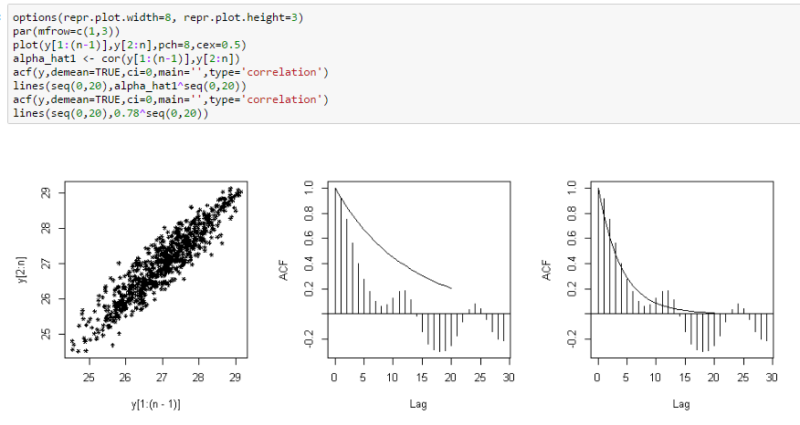
Estimate the autocorrelation function
Python
R

Slide 23
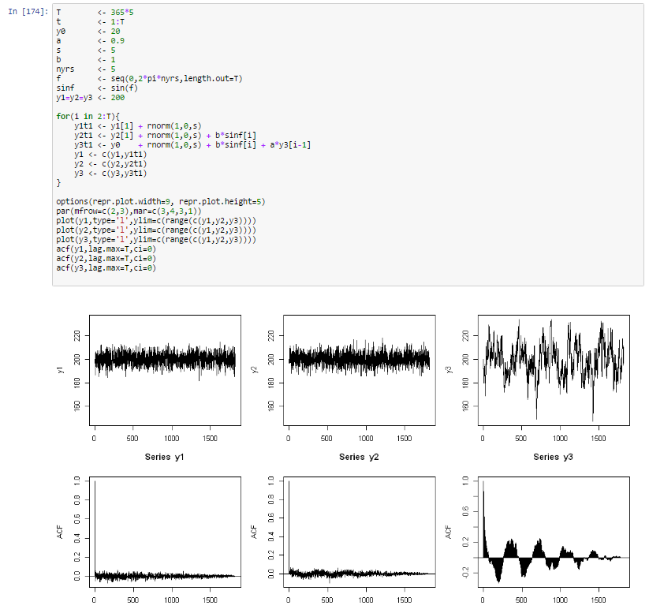
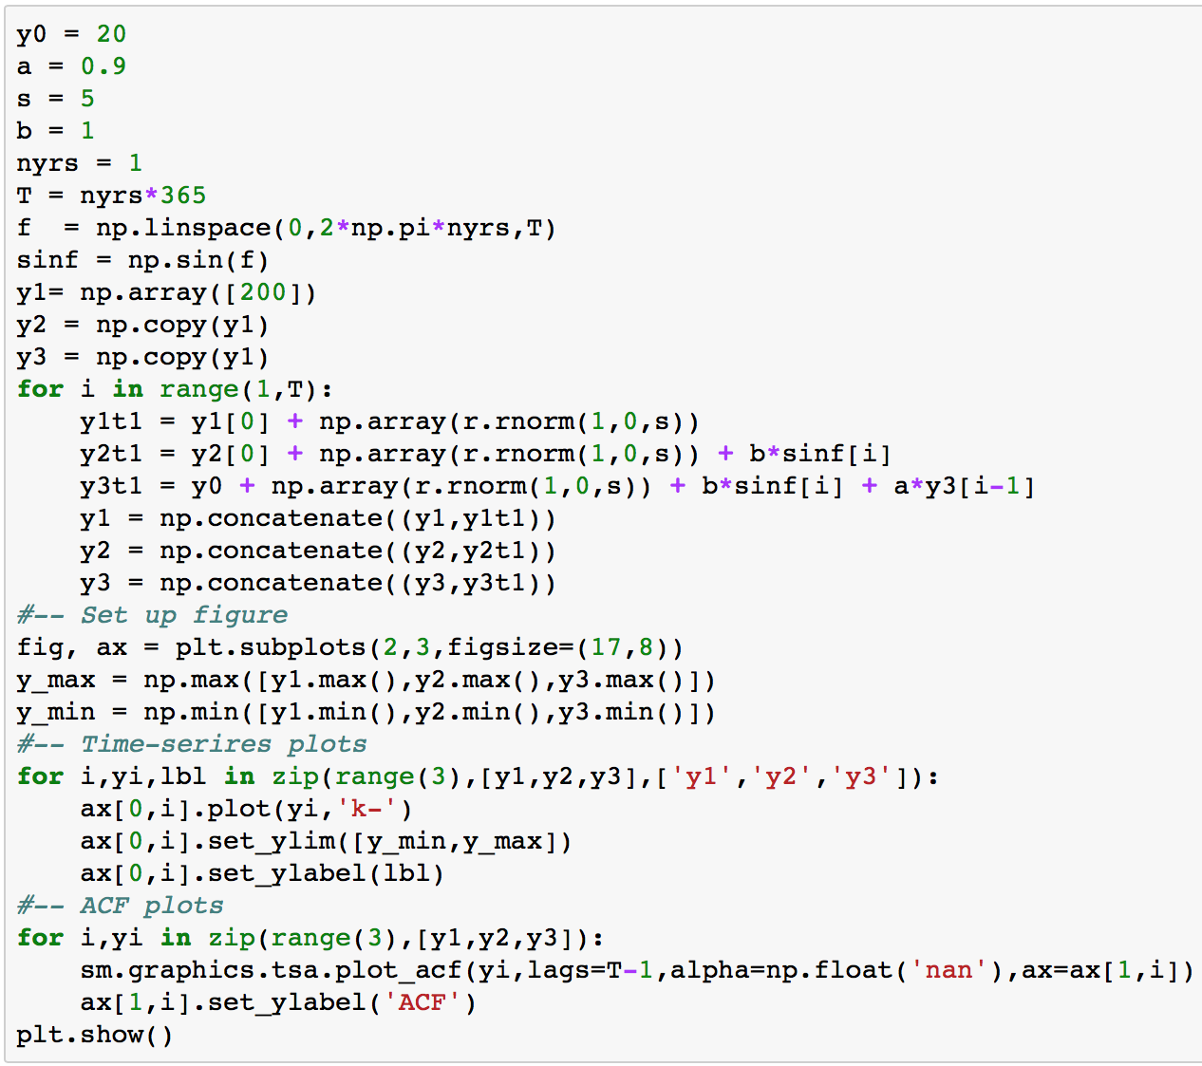
Simulate Different time series with different properties
R
Python

Slide 24

Exercise
Try simulating data with different $a, b, s,$ and $nyrs$ parameters and estimate their autocorrelation function
Try many combinations to build intuition for their effects

Slide 25





The almighty variance-covariance matrix

Slide 26





Fitting a Model with Temporal Autocorrelation
Much weaker evidence!

Slide 27
BREAK

Slide 28


Dataset #1: Ozone time series at single station
What’s Going on with our Air?
EPA Air Quality Station Data, Orange County

Slide 29

Time series of ozone data

Slide 30

Variables n ≡ number of sample
ozone mean daily ozone
ozone_max
hour_max
Variables n ≡ number of sample
ozone mean daily ozone
ozone_max
hour_max

Slide 31

Simple Trend Analysis

Slide 32



Harmonic regression
Include a periodic covariate with frequency w cycles/time and phase eta
This variable is nonlinear in the parameters. Use the double-angle formula and rewrite the variable as two terms with constant coefficients:
Now we can model any frequency with an arbitrary phase using two terms in a linear regression, with

Slide 33

Harmonic regression

Slide 34
Exercise
Look for evidence of a seasonal cycle in other variables in the Orange Country ozone data
Try defining shorter and longer frequencies and fit those variables to the ozone data

Slide 35

An aside: Aliasing
The highest resolvable frequency is that at which observations are resolved. Sampling design can maximize information at particular frequencies

Slide 36

Time Series Decomposition

Slide 37
Exercise
Decompose other variables into their harmonic, trend, and noise components
Do any variables have a significant trend after correcting for seasonality and autocorrelation?

Slide 38

Time series regression

Slide 39
LUNCH

Slide 40

Time series regression

Slide 41

Simple Model Selection
The ‘best’ model is the one that minimizes the criterion
R and Python readily provide these quantities
More interpretable than p.values, but still no replacement for good judgment

Slide 42

Simple Model Selection
R2 always increases with the number of parameters
BIC penalizes more parameters and can be used to select the ‘best’ model

Slide 43
Exercise
Try to find the single best predictor of mean daily ozone concentration, after correcting for seasonality and autocorrelation
Fit multiple regressions and try to find the best model in terms of BIC

Slide 44
Autocorrelation functions

Slide 45

Simulate spatially autocorrelated data

Slide 46

Simulate spatially autocorrelated data

Slide 47
Exercise
Try generating spatial patterns with different decorrelation parameters and look at the resulting patterns

Slide 48

Temperature and Precipitation
Climatology of Oregon

Slide 49

Spatial Interpolation
We often want to ‘fill in’ values where data are not observed
Many techniques of varying complexity
‘Kriging’ is a type of regression model

Slide 50

Spatial interpolation
Often want to ‘fill in the map’

Slide 51

Spatial Interpolation
Numerical packages usually work with the variogram, that includes an additional asymptotic parameter

Slide 52

Spatial Interpolation

Slide 53

Spatial Interpolation

Slide 54
Exercise
Interpolate several variables
Define a new variable, representing the difference in temperature between July and January, and interpolate that variable

Slide 55

Spatial Regression

Slide 56

Spatial Regression

Slide 57

Spatial Regression

Slide 58


Model Selection

Slide 59
Spatial Regression Exercise
Find the best fitting single and multivariable model
Produce a kriged prediction field

Slide 60

Derived spatial variables
Construct a new variable

Slide 61
Exercise
Construct new spatial variables that may capture the effect of the rain shadow and test the relationship with the data while controlling for spatial autocorrelation

Slide 62
Wrapping Up
Learned basic concepts, datasets relatively small
Directly generlizes to higher dimensions, but becomes computationally infeasible with built-in optimizers
Two-day workshop next year using Stan
Hackathon

